Slide 1


Our contribution to the 1 + 2 model in Scotland

Slide 2
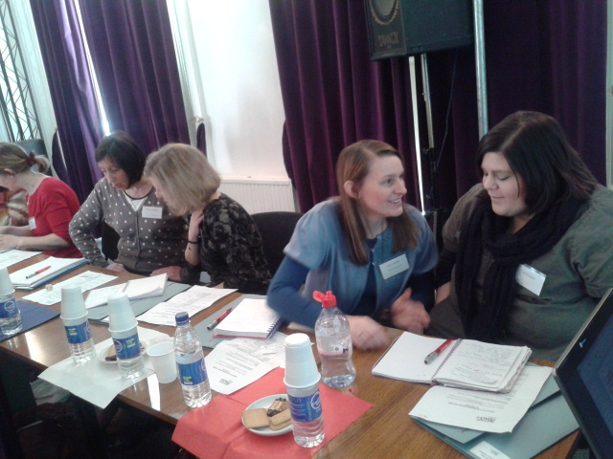
« The training for teachers will require to focus on developping their own language skill level and their understanding of the culture of the countries whose language they are teaching »
Carol Paton, Falkirk Council
The Institut français developed different format of CPDs to better meet the needs of primary teachers.
We ran in 2012/13 across local authorities in Scotland:
- 3 twilight courses (beginners)
- 6 twilight CPDs
- 2 French matinées (A2 / elementary)
- 3 French Days (B1 / intermediate)
= 197 primary teachers

Slide 3
Our contribution to the 1 + 2 strategy
Primary teachers ‘ voices …
“It was all superb!” (Shona A, South Lanarkshire)
“I don’t think anything could have been better”.
(Morag M. , Westlothian)
“Excellent ideas and resources to use in my class” (Fiona L., Clackmannanshire)
“It was all very good!” (Aileen C., North Lanarkshire )
Very well planned and presented. Very professional (Elaine C., Aberdeen)
“Offer more of these sessions ; It was great! merci! “ (Ann H., Eastlothian)

Slide 4
We believe …
☺ Schools partnerships are a powerful and exciting
way of bringing an international dimension into
the classroom.
☺ ☺ Successful school partnerships and collaborative projects have a profound impact on both pupils and teachers.
☺ ☺ ☺ Developing partnerships between Scottish and French local authorities is the easiest way to
facilitate the links between schools, teachers and
pupils.

Slide 5
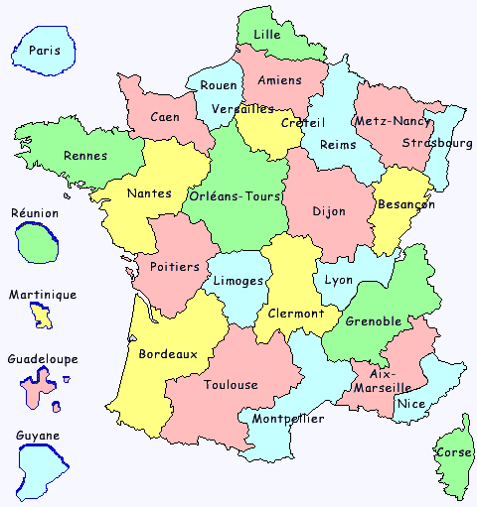
Supporting links between schools, teachers, pupils within local authorities in Scotland and in France
Stirling/ ELA Lille
Fife / ELA Créteil
Dumfries & Galloway / ELA Nancy-Metz
South Lanarkshire / ELA Reims
Renfrewshire/ ELA Lyon
Aberdeen / ELA Clermont Ferrand
Westlothian / ELA Grenoble
Glasgow / ELA Aix-Marseille

Slide 6
Teacher’s voices …
My French language skills benefitted considerably from my stay in France. I was immersed in the language from the very first day of my arrival and always communicate in French with the partner school teachers » (Glenda F., Renfrewshire)
We are pretty much the same and there are more things that connect us than separate us.
(Dympna W., Fife)

Slide 7
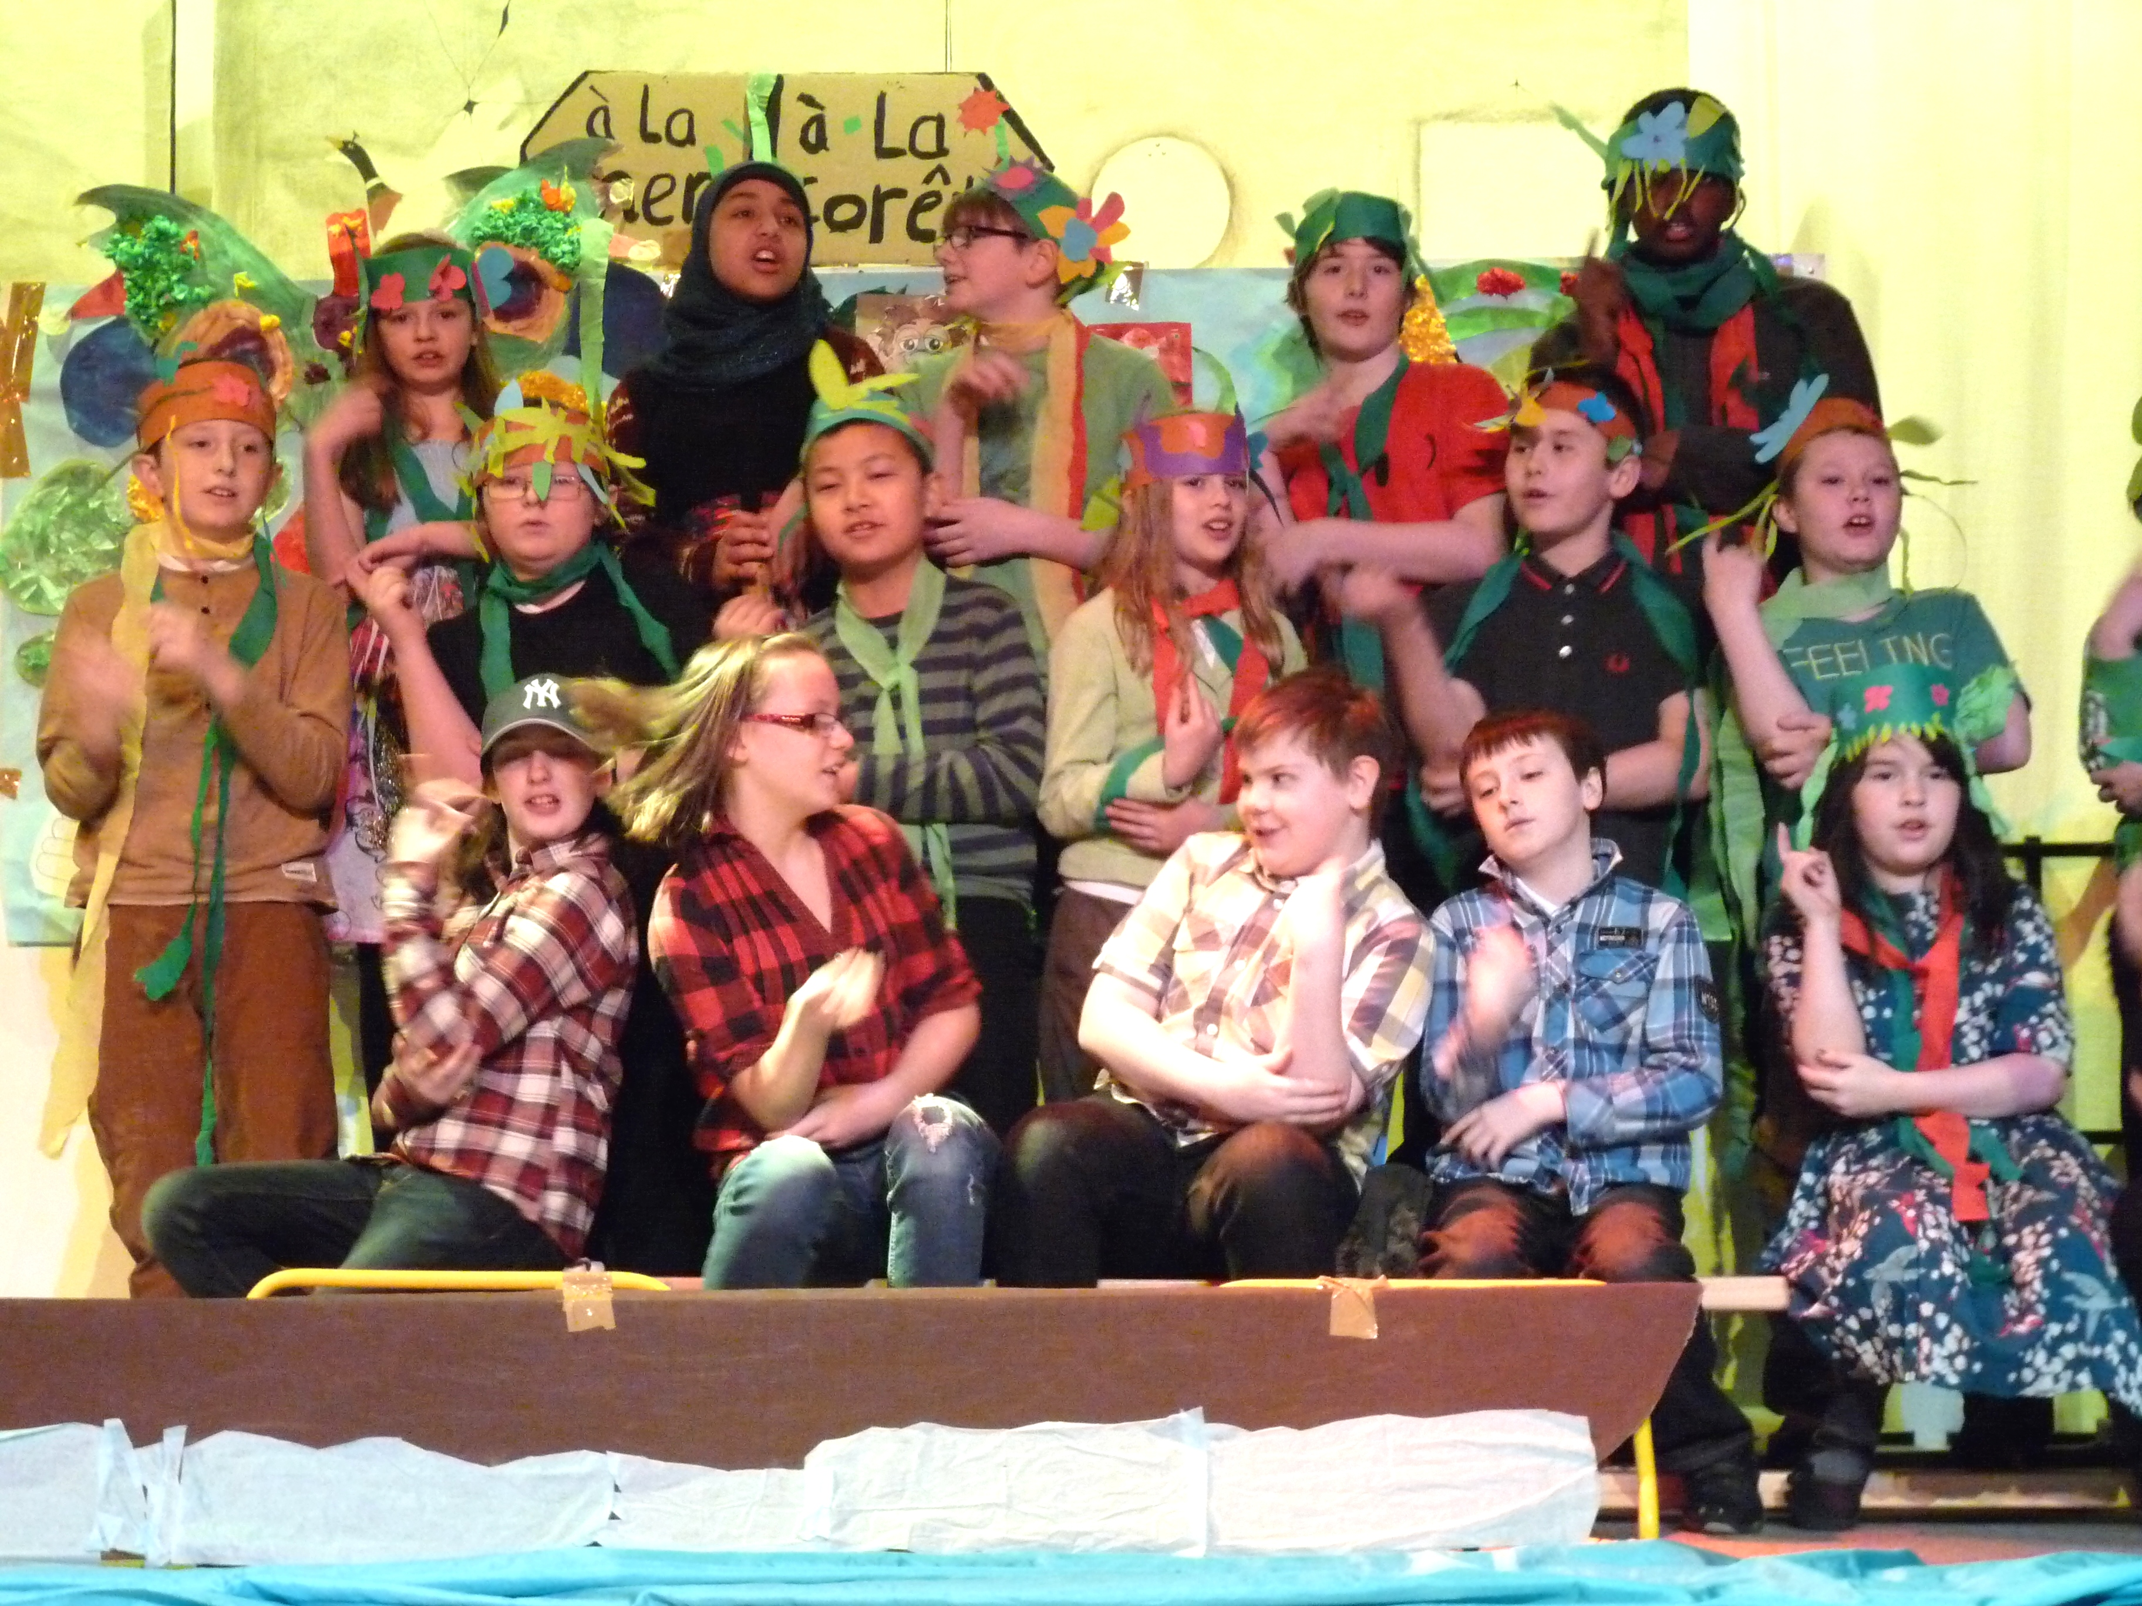
Motivating pupils for French
Rencontres théâtrales Aberdeen (P4/P5/P6)

Slide 8
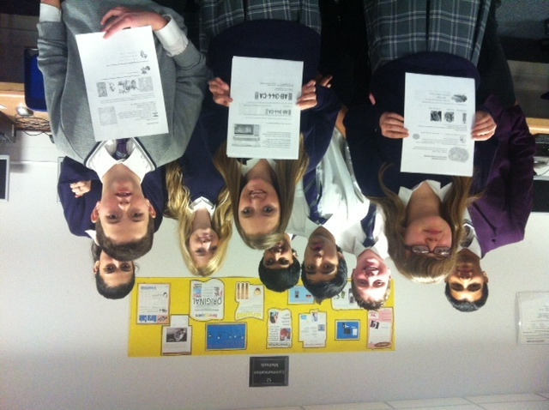
Motivating pupils for French
North Lanarkshire (S5): 135 pupils
Immersion days
Glasgow (S5)
74 pupils
Online competition (S3/S4)
« Vive la Francophonie »
Edinburgh (S6)
45 pupils

Slide 9
Coming up …
CPDs for primary teachers
-Twilight access course for primary teachers (beginners)
- French matinées in Edinburgh on Sat 21 September, 19 October, 23 November 2013, 23 November 2013
- French day on 16 November in Edinburgh
French day in Glasgow (dtc)
+ possibility to certify their level in French
with a DELF certification.

Slide 10
Supporting links between schools in Scotland and in France
Funding for teachers and schools
COMENIUS in service training programme (deadline: 17 September 2013 for a one week shadow training or French courses in France between 1 Jan-30 April 2014)
the Lefèvre trust programme:
http://schoolsonline.britishcouncil.org/programmes-and-funding/the-lefevre-trust
- Extra funding by the Scottish Government for projects about the WWW1
http://home.scotland.gov.uk/home

Slide 11
Next year, we shall carry on on this road …
and continue to support you.
Interested in any of these actions?
Please contact me:
Marie-Christine Thiébaut
education@ifecosse.org.uk
MERCI ! Et à bientôt!

